Slide 1
CSC 101 Introduction to Computing Lecture 19
Mr. Khurram Nissar khurramnissar@cuisahiwal.edu.pk
1

Slide 2
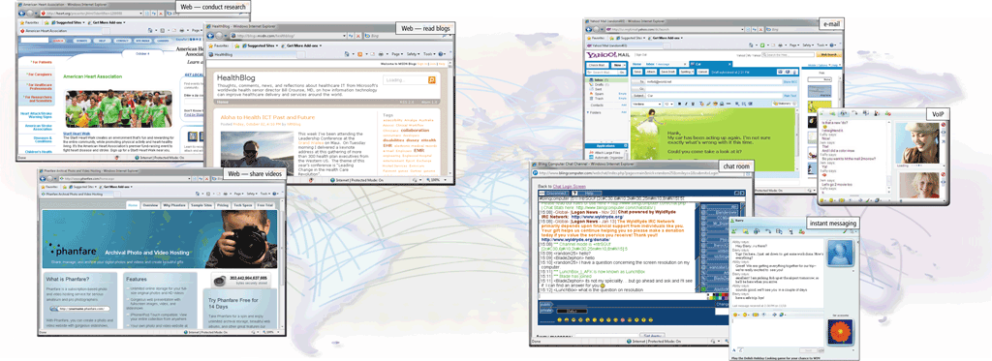
The Internet
The Internet or Net is a worldwide collection of networks that links millions of businesses, government agencies, educational institutions, and individuals

Slide 3
The Internet
Simply put, the Internet is a network of networks— a global communications system that links together thousands of individual networks.
As a result, virtually any computer on any network can communicate with any other computer on any other network.
These connections allow users to exchange messages, to communicate in real time (seeing messages and responses immediately), to share data and programs, and to access limitless stores of information.

Slide 4
Evolution of the Internet
The Internet originated as ARPANET in September 1969 and had two main goals:
Allow scientists at different physical locations to share information and work together
Function even if part of the network were disabled or destroyed by a disaster

Slide 5
The Internet’s History
1969 – ARPANET
Developed by the Department of Defense
Connected universities and defense bases
At first 4 computers one each located at
University of California at Los Angeles
University of California at Santa Barbara
Stanford Research Institute, and
University of Utah
Each of these computers served as a host on the network.
A host, more commonly known today as a server, is any computer that provides services and connections to other computers on a network.
Hosts often use high-speed communications to transfer data and messages over a network.

Slide 6
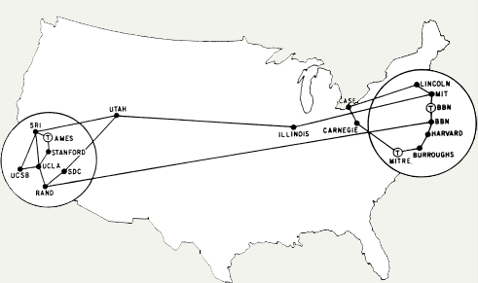
ARPANET 1973
1973 – ARPANET connects to Europe

Slide 7
Evolution of the Internet
1969 ARPANET becomes functional
1984 ARPANET has more than 1,000 individual computers linked as hosts
1986 NSF connects NSFnet to ARPANET and becomes known as the Internet
1995 NSFNet terminates its network on the Internet and resumes status as research network
Today More than 550 million hosts connect to the Internet
1996 Internet2 is founded

Slide 8
The Internet’s History
Mid-1980s – NSFNet
Network between supercomputers
Internet was the link to ARPANET
No commercial traffic allowed
1990s
ARPANET shut down
NSFNet abandoned
Commercial networks take over
Interest in the Internet began to expand dramatically.
The system that had been created as a tool for surviving a nuclear war found its way into businesses and homes
Notes:
Discussion point
Have students discuss the pros and cons of no central control for the Internet. Some discussion points can include copyright issues, free speech, advertisements and information access to all.

Slide 9
Today and the Future
Internet connects thousands of networks and hundreds of millions of users around the world
100,000 new web sites per month
More than 50% of U.S. households online
Access is available throughout the world
huge, cooperative community with no central ownership
Internet consists of many local, regional, national, and international networks.
Numerous corporations, commercial firms, and other companies such as IBM provide networks to handle Internet traffic.
Both public and private organizations own networks on the Internet

Slide 10
World Wide Web Consortium
Oversees research and sets standards and guidelines for many areas of the Internet
Mission of the W3C is to contribute to the growth of the Web
More than 350 organizations from around the world are members of the W3C, advising, defining standards, and addressing other issues
These organizations almost universally support the Internet’s openness and lack of centralized control.

Slide 11
Internet2
Connects more than 200 universities and 115 companies via a high-speed private network
Founded in 1996, the goal of Internet2 is to develop and test advanced network technologies that will benefit Internet users in the short-term future.
These technologies require an extremely high-speed network that exceeds the capabilities of today’s Internet and networks.
Examples of previous Internet2 projects that are now mainstream include telemedicine, digital libraries (online books, magazines, music, movies, speeches, etc.), and faster Internet services.
Current Internet2 projects include interactive high-definition video and enhanced detection and resolution of network problems.

Slide 12
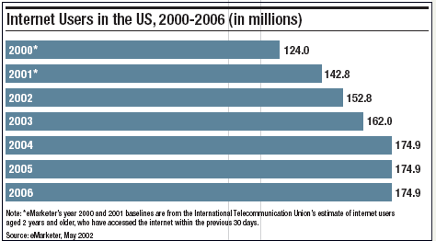
U.S. Internet Growth

Slide 13
Evolution of the Internet
Many home and small business users connect to the Internet via high-speed broadband Internet service
Cable Internet service
DSL
Fiber to the Premises (FTTP)
Fixed wireless
Cellular Radio Network
Wi-Fi
Satellite Internet Service

Slide 14
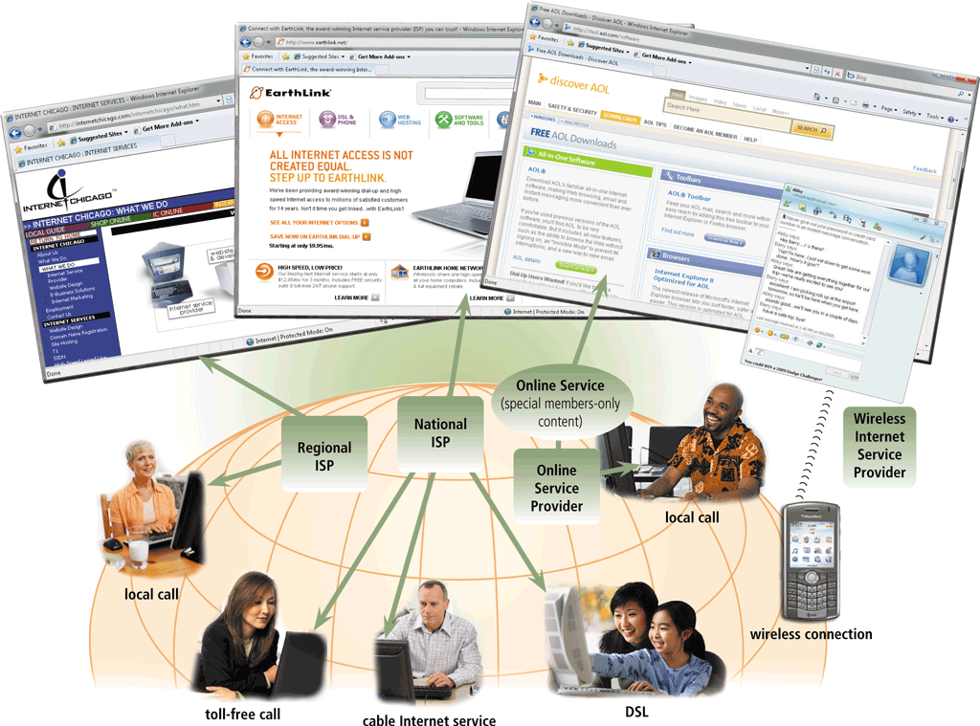
Evolution of the Internet
An access provider is a business that provides individuals and organizations access to the Internet free or for a fee

Slide 15
Evolution of the Internet
ISP (Internet service provider)
Online service provider (OSP)
Wireless Internet service provider (WISP)
Regional ISPs provide Internet access to a specific geographical area
National ISPs provide Internet access in cities and towns nationwide
Has many members-only features
Popular OSPs include AOL (America Online) and MSN (Microsoft Network)
Provides wireless Internet access to computers and mobile devices
May require a wireless modem

Slide 16
Understanding the Internet
The Internet allows accessing resources
Many people believe that the Web and the Internet are the same thing, but this is not correct. In fact, they are two different things
Web is a service (a system for accessing documents) that is supported by the Internet (a gigantic network).
The Web simplifies the Internet
The Web connects documents
Hypertext creates links between documents
Documents are stored on a web server
HTTP delivers documents
Notes:
Teaching tip
Find out who has a web presence. If the site is appropriate, display it in class. Have the student discuss what is needed to establish and maintain a web presence.

Slide 17
Understanding the Internet
Web site is a collection of documents
Document is a web page
Pages are published to the web
Hypertext Markup Language (HTML)
Creates web pages
Describes how pages should look
Content enclosed in tags
<tag>content</tag>
Notes:
Teaching tip
Show your students how to access the HTML of an appropriate web site.

Slide 18
Understanding The Internet
Browsers
a software application designed to find hypertext documents on the Web and then open the documents on the user’s computer
Read and translate the HTML
Display web content
Uniform Resource Locator (URL)
Address of a web page
Notes:
Teaching Tip
Dissect the URL provided.

Slide 19

Evolution of the Internet
An IP address is a number that uniquely identifies each computer or device connected to the Internet
A domain name is the text version of an IP address
Top-level domain (TLD)
A DNS server translates the domain name into its associated IP address

Slide 20
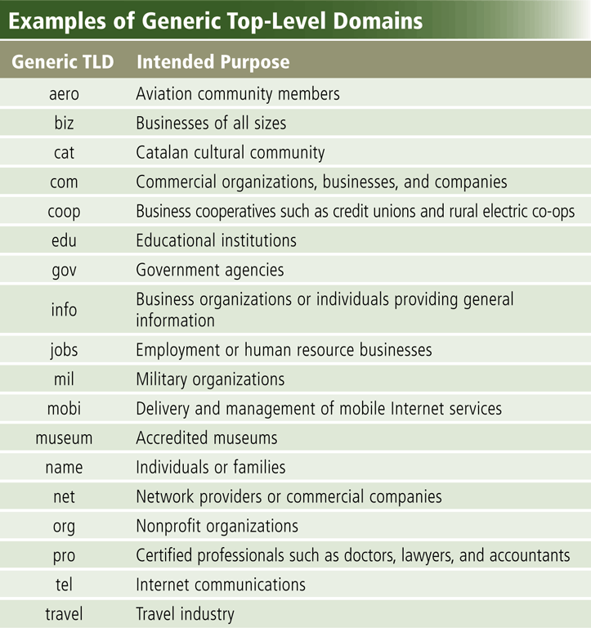
World Wide Web

Slide 21
The World Wide Web
The World Wide Web, or Web, consists of a worldwide collection of electronic documents (Web pages)
A Web site is a collection of related Web pages and associated items
A Web server is a computer that delivers requested Web pages to your computer
Web 2.0 refers to Web sites that provide a means for users to interact

Slide 22
The World Wide Web
A Web browser, or browser, allows users to access Web pages and Web 2.0 programs
Internet Explorer
Firefox
Opera
Safari
Google Chrome

Slide 23
Understanding The Internet
Helper applications
Plug-ins
Enhance a browser’s functionality
Streaming audio and video
Sends the file in small chunks
Chunks downloaded while others play
Notes:
Teaching point
Direct the students to several different streaming video sites. Www.launch.com and www.apple.com/QuickTime are two excellent examples. Be sure your classroom browsers have the appropriate plug-ins.

Slide 24
Using a Browser And The WWW
Browser starts on the home page
Navigating the web
Enter a URL in the browser
Click a link
Links are typically blue underlined words
Image maps are picture links
When finished, close the browser

Slide 25
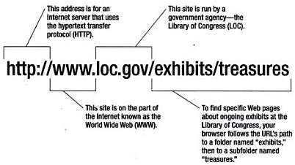
URL
Uniform Resource Locator
Type://Address/path
Type – type of server (protocol, http://)
Address – address of the server
Path – location within the file structure of server

Slide 26
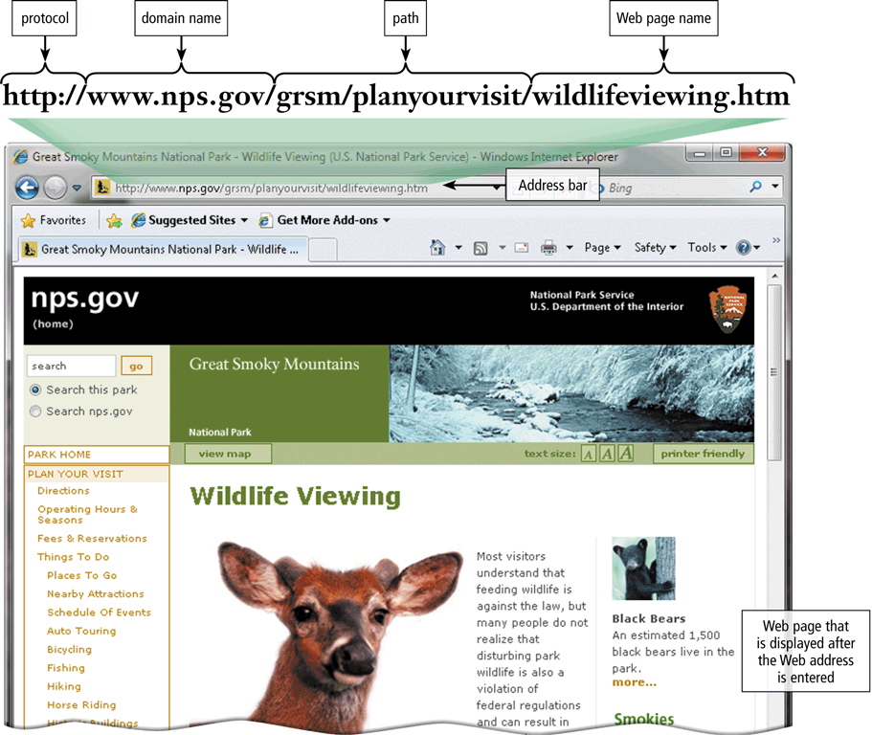
URL and Web Server
A Web page has a unique address called a URL or Web address
A web server delivers the Web page to your computer

Slide 27
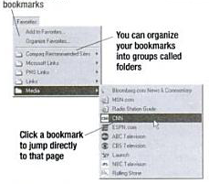
Using a Browser And The WWW
Web pages and Web site
Browser starts on the home page
Navigating the web
Enter a URL in the browser
Click a hyperlink
Links are typically blue underlined words
Image maps are picture links
Store the URL in the browser’s Favorites / Bookmarks list
When finished, close the browser

Slide 28
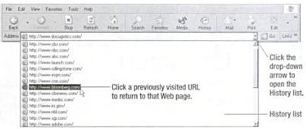
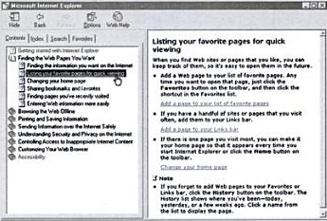
History and Help

Slide 29
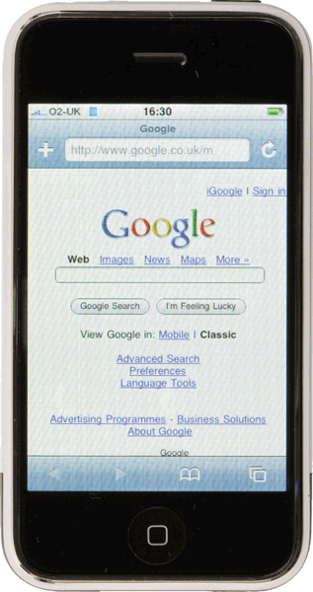
Home Page and Downloading
A home page is the first page that a Web site displays
Web pages provide links to other related Web pages
Surfing the Web
Downloading is the process of receiving information
Some Web pages are designed specifically for microbrowsers

Slide 30
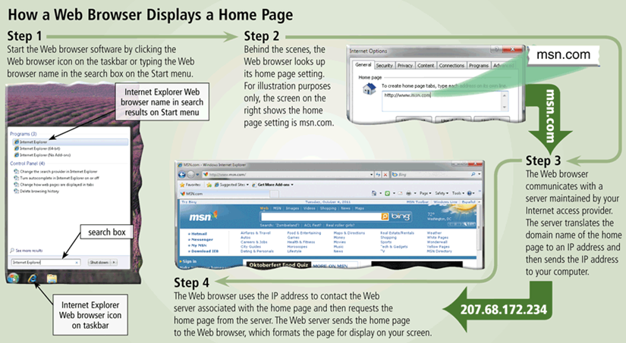
Displaying Home Page

Slide 31
Link
Built-in connection to another related Web page location
Item found elsewhere on same Web page
Different Web page at same Web site
Web page at a different Web site

Slide 32
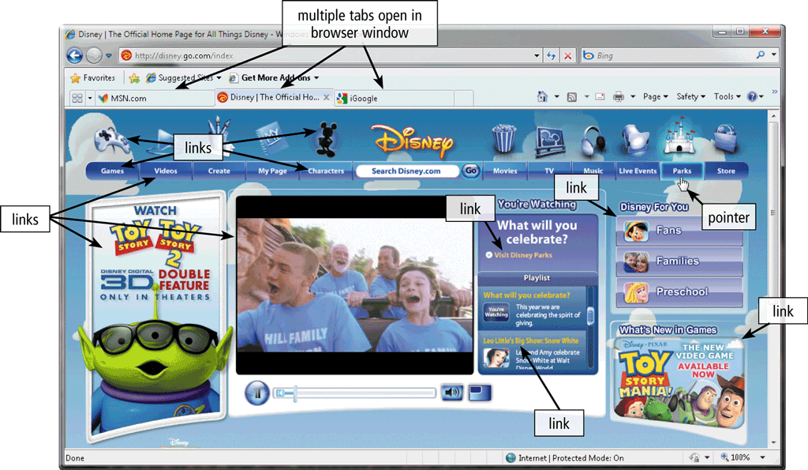
Tabbed Browsing
allows you to open and view multiple Web pages in a single Web browser window

Slide 33
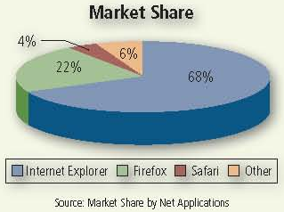
Web Browser Market share
Windows Internet Explorer (IE) currently is the most popular browser, with approximately 68 percent of the market share

Slide 34
Search Tools
Two types of search tools are search engines and subject directories
Search engine
Finds information related to a specific topic
Subject directory
Classifies Web pages in an organized set of categories

Slide 35
Subject Directory
A subject directory provides categorized lists of links
Search tool with organized set of topics and subtopics
Lets you find information by clicking links rather than entering keywords
specializes in linking to other web sites and categorizing those links
not a search engine and does not display lists of web pages based on keywords; instead, it lists web sites by category and subcategory.

Slide 36
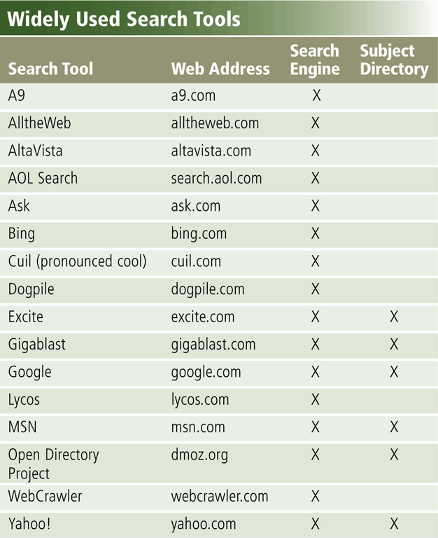
Search Engine
Program used to find Web sites and Web pages by entering words or phrases called search text
Also called a keyword
Some search engines also mine data available in databases or open directories
search engines also maintain real-time information by running an algorithm on a web crawler

Slide 37
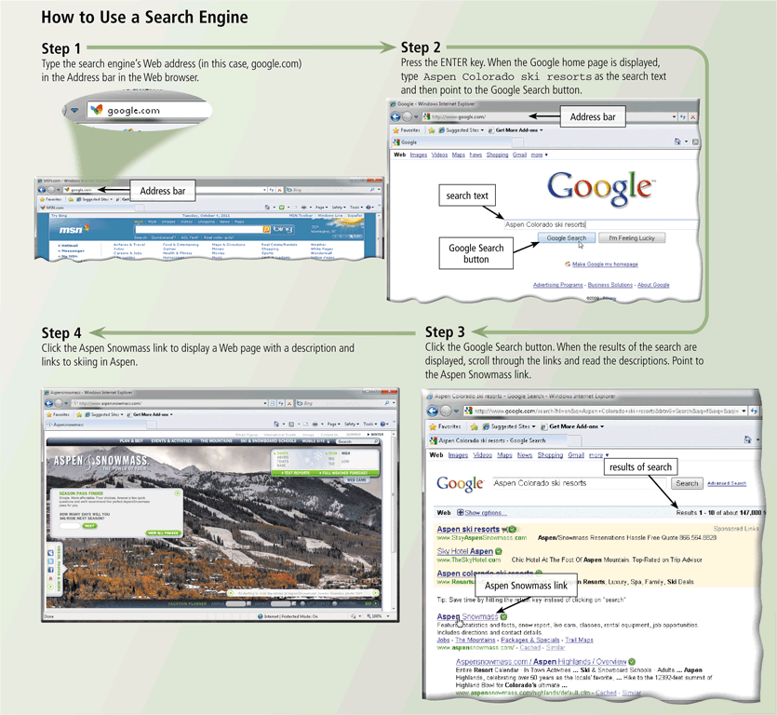
Using a Search Engine

Slide 38
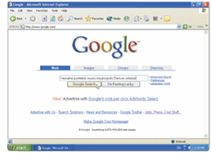
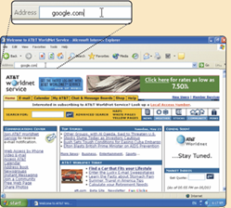
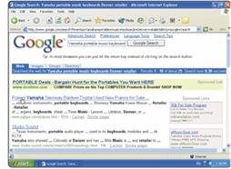
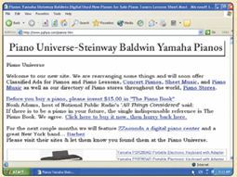
Search Hit
Any Web site name that is listed as the result of a search
Step 2. Select type of search you want to run
Step 1. Go to search engine
Step 3. View hits
Step 4. Click link to view Web site

Slide 39
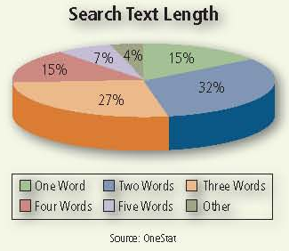
Search Text Word Length
Internet users most often use only two words in their search text.

Slide 40
Search Engine Items
A search engine is helpful in locating items such as:
Images
Videos
Audio
News
Maps
People or Businesses
Blogs

Slide 41
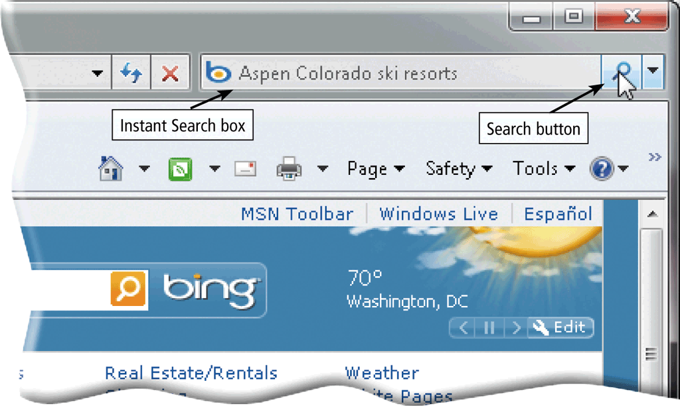
The World Wide Web
Some Web browsers contain an Instant Search box to eliminate the steps of displaying the search engine’s Web page prior to entering the search text

Slide 42
Searching the Web
Site searches
Large sites have an internal search
Metasearch sites
Search several web sites at once
Sponsored links
Sites pay for better search results
Notes:
Insider information
The search engine www.google.com has become one of the hottest search engines on the planet. It is so popular, it’s name has become a verb. For example, “I googled the answer last night” is a phrase uttered on college campuses the world over.

Slide 43
Search Techniques
Quote the exact phrase
Use the keyword AND
Use the keyword NEAR
Avoid common words
Use the site’s advanced tools
Use specific nouns.
Put the most important terms first in the search text.
List all possible spellings, for example, email, e-mail.
Before using a search engine, read its Help information.
If the search is unsuccessful with one search engine, try another

Slide 44
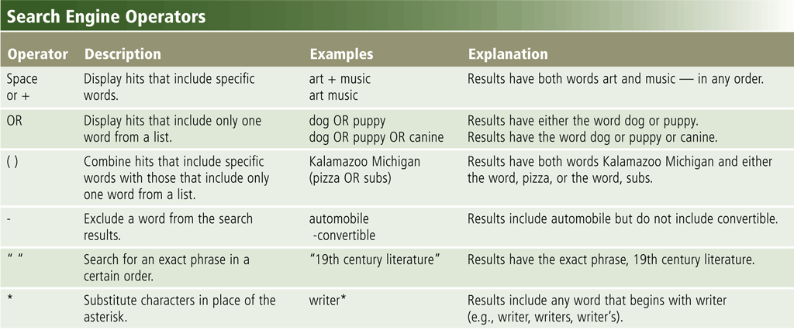
The World Wide Web
Search operators can help to refine your search

Slide 45
The World Wide Web
There are thirteen types of Web sites
Portal
News
Informational
Business/Marketing
Blog
Online Social Network
Educational
Wiki

Slide 46
The World Wide Web
Entertainment
Advocacy
Web Application
Content Aggregator
Personal

Slide 47
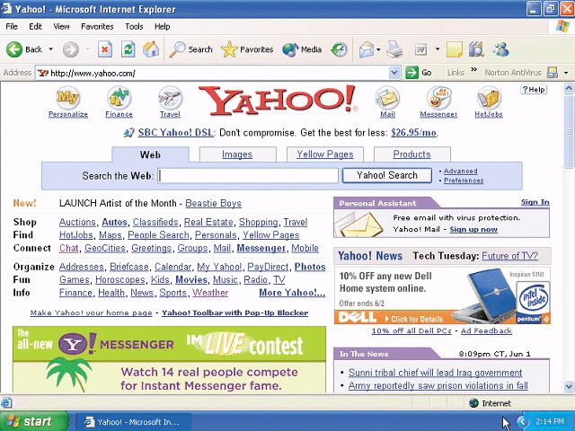
Portal
A Web site that offers a variety of services from one, convenient location, usually for free
Searching, sports, e-mail, news, weather, auctions, Web communities (Web sites that join people with similar interests)

Slide 48
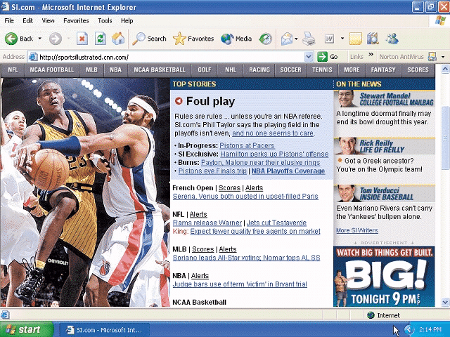
News Web Site
Contains newsworthy material
Stories and articles relating to current events, life, money, sports, and the weather

Slide 49
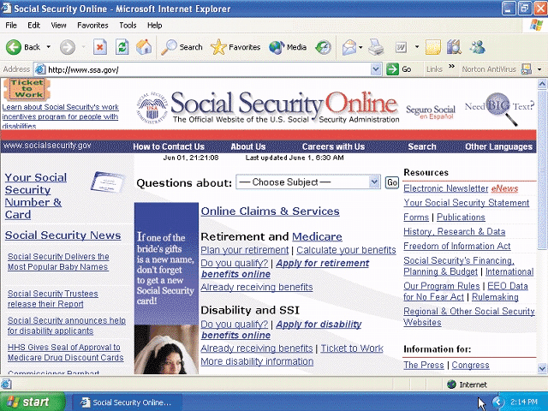
Informational Web site
Contains factual information
Created by organizations and government agencies

Slide 50
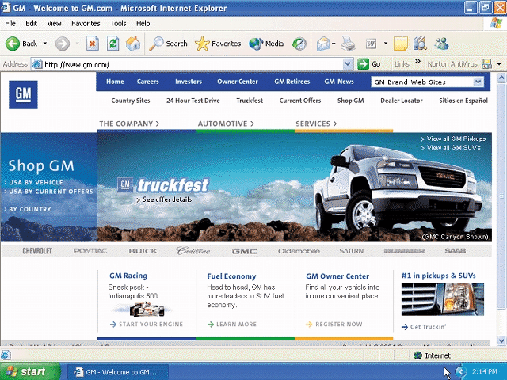
Business / Marketing Website
Contains content that promotes products or services
Allows you to purchase products or services online

Slide 51
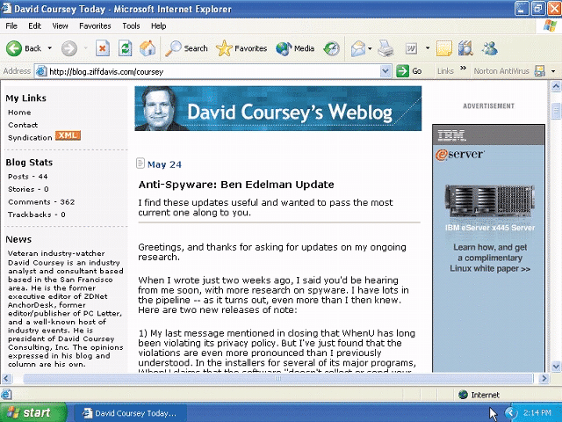
Blog
Uses a regularly updated journal format to reflect the interests, opinions, and personalities of the author and sometimes site visitors

Slide 52
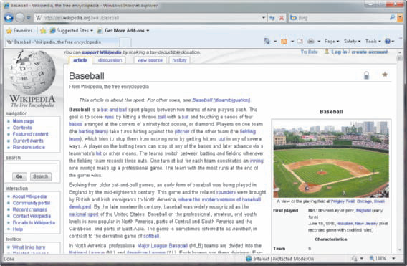
Wiki
A wiki is a collaborative Web site that allows users to create, add to, modify, or delete the Web site content via their Web browser.
52
Notes:
Insider Information
Plug and play was introduced by Apple Computers.

Slide 53
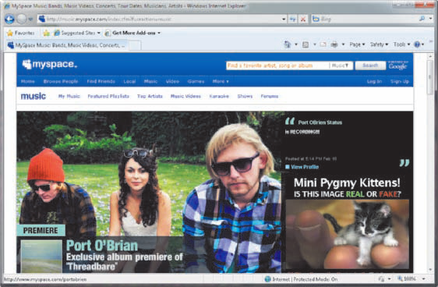
Online Social Network
A Web site that encourages members in its online community to share their interests, ideas, stories, photos, music, and videos with other registered users

Slide 54
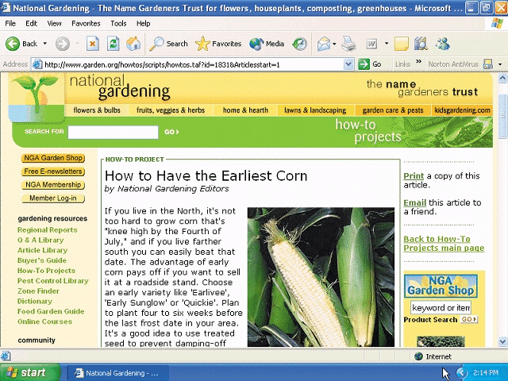
Educational Web Site
Offers avenues for formal and informal teaching and learning
Some companies offer online training for employees
Some colleges offer online classes and degrees

Slide 55
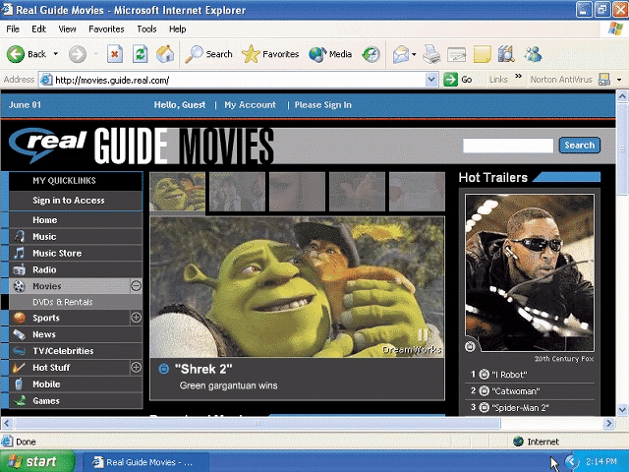
Entertainment Web site
Offers an interactive and engaging environment featuring music, video, sports, games, and more

Slide 56
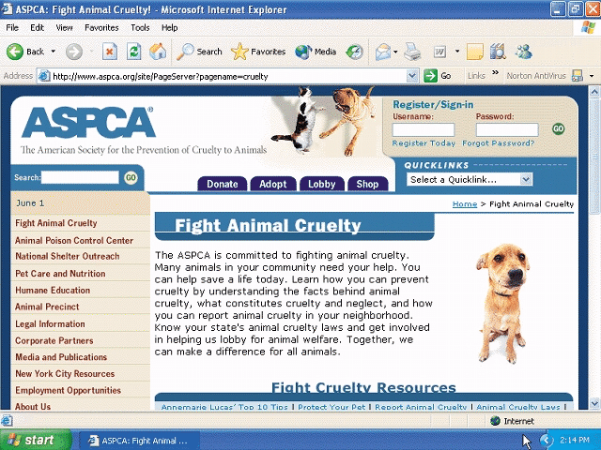
Advocacy Web Site
Contains content that describes a cause, opinion, or idea

Slide 57
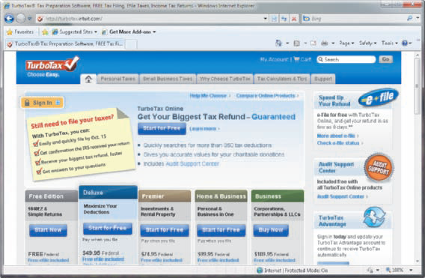
Web Application
A Web application, or Web app, is a Web site that allows users to access and interact with software through a Web browser on any computer or device that is connected to the Internet.

Slide 58
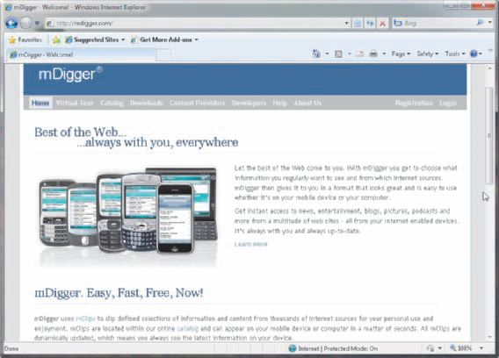
Content Aggregator
A business that gathers and organizes Web content and then distributes, or feeds, the content to subscribers for free or a fee
RSS 2.0 and Atom

Slide 59
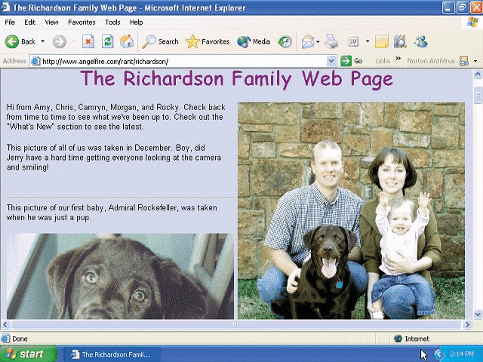
Personal Website
Web page maintained by private individual
Reasons: sharing life experience with the world or job hunting

Slide 60
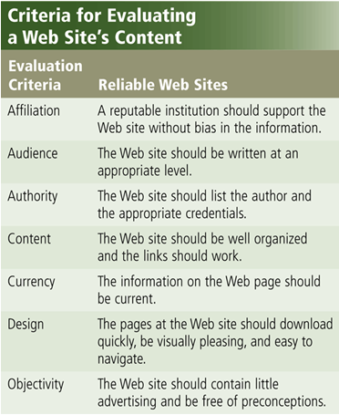
Evaluating a Web Site Content
Information presented on the Web must be evaluated for accuracy
No one oversees the content of Web pages

